Slide 1
Formal Methods

Slide 2

What are formal methods?
Formal methods are a series of techniques for proving the ‘correctness’ of a program, in a mathematical sense. Essentially, they verify that the logical assumptions that you make about your system are true.
They’re usually reserved for mission-critical systems (think NASA, major financial and medical software, etc), but 1) they’re cool and 2) this talk will focus on a few specific techniques that have begun to be used in the industry more widely.
Notes:
This is going to be a very high level survey of formal methods ideas and techniques - any one of them could probably be their own dev talk, but given that this is a way of looking at code I’d never encountered before and thought was neat, I thought I’d start with a general tour, and then if there’s interest we could dive in further at a later date.

Slide 3
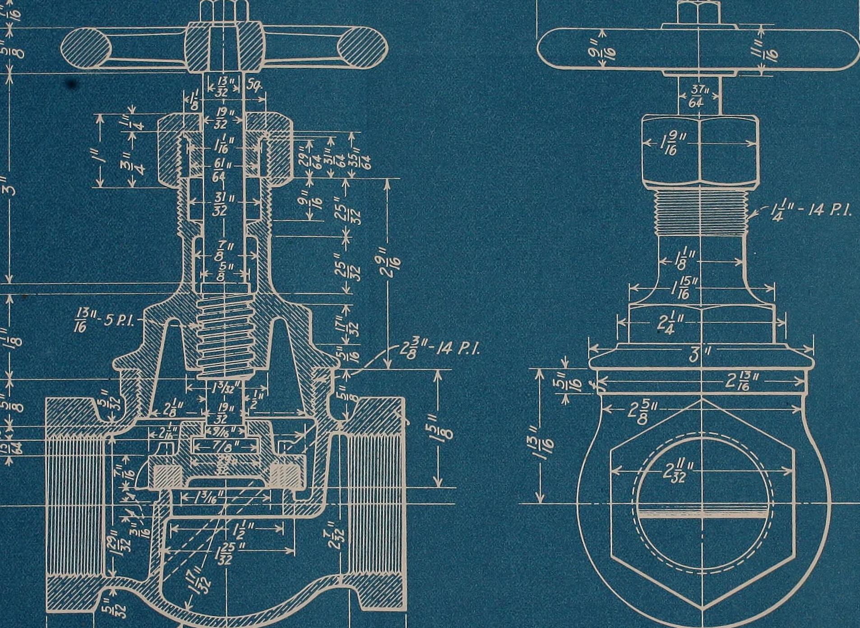
Formal specifications
Formal specifications are logical representations of your system! Essentially blueprints for a process you’re building.
There are a few specification languages in use. Let’s take a look at modeling the flow for a 0 downtime deployment with one of them, TLA+.
Bonus example of modelling a redux store located here.
Notes:
Formal specifications are one of the tools that’s starting to see more industry adoption. They are coded, but rather than being an executable part of your application, they’re a precise description of the logical operations your system takes when it runs. They have the benefit of being able to quickly model a flow across service boundaries, and are good at catching concurrency bugs and logical flaws even in the early stages of system design.

Slide 4
Dependent Types, Refinement Types, and Contracts
Stealing a quote from a conference I attended recently; “types are specifications!’
That is, they’re a formal verification that your inputs and outputs have certain properties. However, we’re limited in what we can verify by the types that exist in the language we choose.
Some languages, like Haskell, that are more influenced by formal methods have concepts called dependent types and refinement types.
Notes:
I could do a whole separate talk on the history of types, but here I’ll stick to talking about some formal methods notions that might extend the way you think of types. [talk directly about slide] We often verify the logic encapsulated by these type examples with tests / validation methods in our services and actions. However, as we all know, tests are a lot slower than compile-time verification!

Slide 5
Dependent Types, Refinement Types, and Contracts
Dependent types are types that depend on a value - so the type of N * 3 or the type of a list of 2 integers.
Refinement types are basically existing types with preconditions, like the type of integers between 0 and 1000.
Contracts are code that can verify the same conditions as dependent or refinement types, but are enforced with static checking or at runtime rather than via the type system.

Slide 6
Dependent Types, Refinement Types, and Contracts
C#, alas, is one of those languages that does not support dependent and refinement types.
You can mimic some of the effects of a dependent types in C#, but it’s far from seamless. C#’s functional cousins F# and F* have support for more complex typing, and SuccincT’s discriminated union types can be thought of as being dependent type-like due to their ability to represent a family of types as a single type (ie. Union<IntLessThan1000, FloatLessThan1000>)

Slide 7

Dependent Types, Refinement Types, and Contracts
Contracts provide another way of bringing some of these complex typing ideas to C#.
One of their biggest benefits from my point of view is that they can be checked statically, locally, instead of at runtime.
Notes:
Some ways of checking contracts happen at runtime, which I find less useful, but some can be checked statically! The more validation we can do at compile time vs build time, the smoother development will go for all of us.

Slide 8
Dependent Types, Refinement Types, and Contracts
An object invariant contract might look like this:
[ContractInvariantMethod] protected void BillContract() { Contract.Invariant(Amount >= 0); Contract.Invariant(Paid <= Amount); }
While a pre-condition and post-condition would look like this:
public double CalculateDiscount(int originalAmount, string discountCode) { Contract.Requires(originalAmount >= 0); Contract.Ensures(Contract.Result<double>() >= 0); return -32; }
Notes:
Some ways of checking contracts happen at runtime, which I find less useful, but some can be checked statically! The more validation we can do at compile time vs build time, the smoother development will go for all of us.

Slide 9
Property-based testing
Property based testing is another way of verifying your program’s behaviour that focuses more on specification than examples. Instead of writing tests that take a specific input and expect a specific output, you can write tests that take a type of input and return a type of output.
In this way, you can verify 100s of scenarios with the same amount of code you’d use to write one test! Let’s take a quick look at an example.
Notes:
essentially the verification provided by dependent types in the form of tests instead of compilation.

Slide 10
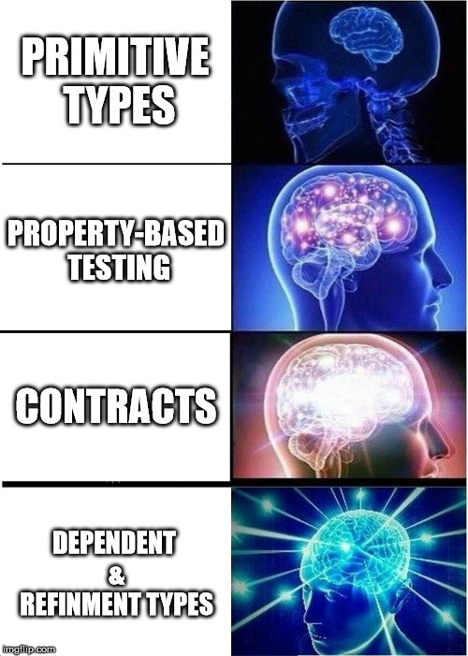
Dependent Types, Refinement Types, and Contracts
TLDR;
Notes:
Incredibly reductive, but basically gets the idea across!

Slide 11
Program synthesis
There are now some program synthesis tools like Synquid (refinement type-based) that can write programs for you, based on a specification! Here’s an interactive Synquid demo that produces a function that returns N copies of a variable from a series of examples.
Notes:
I’m mostly just including this because it’s cool, and because it answered some of the questions that arose for me from specification languages. One frustrating thing about writing formal specifications is that even at the end of writing a beautiful, logically-sound spec, you still need to go out and actually implement it. Once you’ve created formal enough specifications, why should you need to go implement them by hand? Isn’t translating logical operations into action what coding is all about?

Slide 12
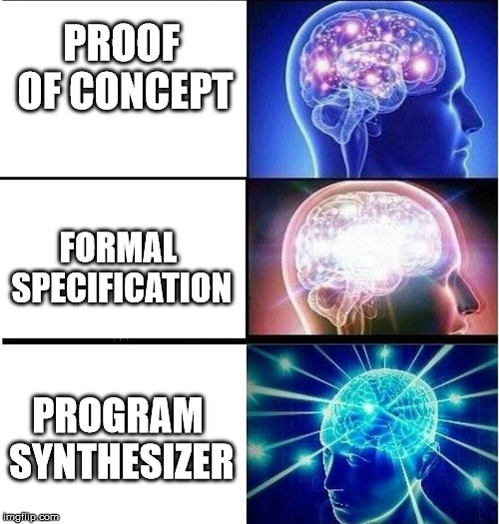
Specifications & Program Synthesizers
TLDR;

Slide 13
So what?
This talk is mostly exploratory, because formal methods are cool! However, some near-future use cases I can imagine are:
Using TLA+ to architect some of our new microservice flows
Doing a POC using C# code contracts to see if we could replace some tests with static verification
Experimenting with property-based testing

